Slide 1
International Trade

Slide 2
International Trade
Internal or domestic trade are meant transactions taking place within the geographical boundaries of a nation or region. It is also known as intra-regional or home trade.
International trade, on the other hand, is trade among different countries or trade across political frontiers.
Inter-regional also refers to trade transactions within different regions of a country.

Slide 3
Features
Immobility of Factors
The degree of immobility of factors like labour and capital is generally greater between countries than within a country. Immigration laws, citizenship, qualifications, etc. often restrict the international mobility of labour.
Heterogeneous Markets
In the international economy, world markets lack homogeneity on account of differences in climate, language, preferences, habit, customs, weights and measures, etc. The behaviour of international buyers in each case would, therefore, be different.

Slide 4
Cotnd..
Different national and political units
International trade takes place between differently cohered groups. The socio-economic and political environment differs greatly among different nations
Different currencies
Another notable feature of international trade is that it involves the use of different types of currencies. So, each country has its own policy in regard to exchange rates and foreign exchange.

Slide 5
Theory of Absolute Advantage-Adam Smith
The trade theory that first indicated importance of specialization in production and division of labor is based on the idea of theory of absolute advantage which is developed first by Adam Smith in his famous book The Wealth of Nations published in 1776.
Absolute Advantage: If a country or individual absolutely more efficient at production of a good than another country or individual, then we say that she has absolute advantage in the production of that good.

Slide 6
Assumptions
Factors of production can not move between countries.
No barriers to trade in goods.
Exports must be equal to imports
Labor is the only relevant factor of production.
Production exhibits constant returns to scale Constant Returns to Scale (CRS)

Slide 7
Example
 | A | B
Cheese | 2 | 10
Wine | 8 | 4
A has absolute advantage in production of cheese as it takes fewer hours to produce a unit of cheese in A than in B.
Since it takes less hours in B to produce wine, B has an absolute advantage in production of wine.

Slide 8
Adam Smith’s theory: Countries should specialize in the production of goods in which they have an AA.
So A will be better of it specializes in the production of C and
B will be better of if it specializes in W.
So they don’t need to produce both goods at home.

Slide 9
Theory of Comparative Advantage- David Ricardo
Comparative Advantage: If a country or individual is relatively more efficient in the production of a good than another country or individual then we say that she has comparative advantage in production of that good.
Adam Smith’s theory says that countries will be better of in specializing the good at which they have AA.
But what happens if one of the countries has AA in production of both goods? Should they abandon trade?

Slide 10
Example
 | A | B
Cheese | 6 | 12
Wine | 2 | 18

Slide 11
Contd..
In this example, A has AA in production of both C and W.
David Ricardo’s theory of comparative advantage which says that a country has a CA in a good if the good has a lower relative price in autarky than is found in the other country.
This theory indicates that we need to look at the cost of product in each country before the trade(in autarky) and compare it with trade situation and compute gains/losses from trade.

Slide 12
Contd..
In the example above, A is 2 (12/6) times more efficient in production of C than B, while 9 times more efficient in production of W.
Thus A has more AA in production of W compared to C.
So, if trade takes place A will tend to produce more W as W is relatively cheaper in A than in B.

Slide 13
Contd..
What about B? According to theory of comparative advantage B should expand its production of C as the cheese production in B is relatively less costly.
According to theory of comparative advantage B should expand its production of C as the cheese production in B is relatively less costly.
How do we know this? We compare autarky relative prices. What is the relative price of W in autarky in A and B?

Slide 14
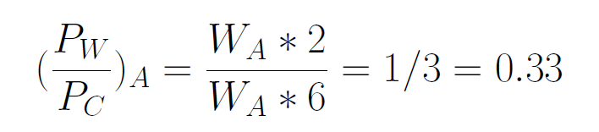
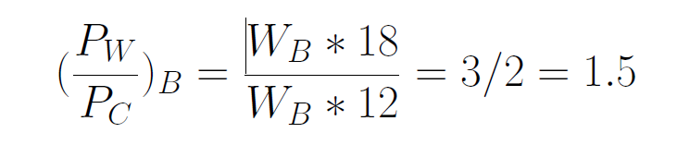
Contd..

Slide 15
Contd..
So in autarky, W is cheaper in A than in B. Taking the reciprocals of above relative prices w e find the relative price of C in terms of W in A and B respectively.
As it is clear from the equation above, C is cheaper in B than in A
Hence, in autarky, opportunity cost of W in A is lower than that in B, indicating that A’s producers are relatively more efficient in W rather than in C. The opposite holds true for B’s producers. According the law of comparative advantage once trade allowed between the two countries, A should specialize in W and B in C.

Slide 16
Resources and Trade Hecksher- Ohlin(HO)Model

Slide 17
Introduction
In the real world, while trade is partly explained by differences in labor productivity, it also reflects differences in countries’ resources.
The Heckscher-Ohlin theory:
Emphasizes resource differences as the only source of trade
Shows that comparative advantage is influenced by:
Relative factor abundance (refers to countries)
Relative factor intensity (refers to goods)
Is also referred to as the factor-proportions theory
Hecksher-Ohlin Theorem: The country that is abundant in a factor exports the good whose production is intensive in that factor.

Slide 18
A Model of a Two-Factor Economy
Assumptions of the Model
An economy can produce two goods, cloth and food.
The production of these goods requires two inputs that are in limited supply; labor (L) and land (T).
Production of food is land-intensive and production of cloth is labor-intensive in both countries.
Perfect competition prevails in all markets.

Slide 19
Effects of International Trade Between Two-Factor Economies
Relative Prices and the Pattern of Trade
Factor Abundance
Home country is labor-abundant compared to Foreign country (and Foreign is land-abundant compared to Home) if and only if the ratio of the total amount of labor to the total amount of land available in Home is greater than that in Foreign:
L/T > L*/ T*
Example: if America has 80 million workers and 200 million acres, while Britain has 20 million workers and 20 million acres, then Britain is labor-abundant and America is land-abundant.
In this case, the scarce factor in Home is land and in Foreign is labor.

Slide 20
A Model of a Two-Factor Economy
Factor Intensity
In a world of two goods (cloth and food) and two factors (labor and land), food production is land-intensive, if at any given wage-rental ratio the land-labor ratio used in the production of food is greater than that used in the production of cloth:
T_{F}/L_{F} > T_{C}/ L_{C}
Example: If food production uses 80 workers and 200 acres, while cloth production uses 20 workers and 20 acres, then food production is land-intensive and cloth production is labor-intensive.

Slide 21
Effects of International Trade Between Two-Factor Economies
Assumptions of the Heckscher-Ohlin model:
There are two countries (Home and Foreign) that have:
Same tastes
Same technology
Different resources
Home has a higher ratio of labor to land than Foreign does
Each country has the same production structure of a two-factor economy.

Slide 22
A Model of a Two-Factor Economy
An increase in the supply of land (labor) leads to a biased expansion of production possibilities toward food (cloth) production.
The biased effect of increases (decreases) in resources on production possibilities is the key to understanding how differences in resources give rise to international trade.
An economy will tend to be relatively effective at producing goods that are intensive in the factors with which the country is relatively well-endowed.

Slide 23
Effects of International Trade Between Two-Factor Economies
When Home and Foreign trade with each other, their relative prices converge. The relative price of cloth rises in Home and declines in Foreign.
In Home, the rise in the relative price of cloth leads to a rise in the production of cloth and a decline in relative consumption, so Home becomes an exporter of cloth and an importer of food.
Conversely, the decline in the relative price of cloth in Foreign leads it to become an importer of cloth and an exporter of food.

Slide 24
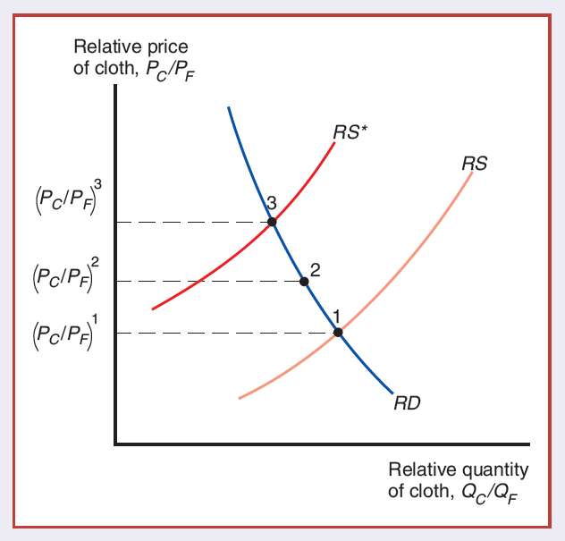
Trade Leads to a Convergence of Relative Prices
In the absence of trade, Home’s equilibrium would be at point 1, where domestic relative supply RS intersects the relative demand curve RD. Similarly, Foreign’s equilibrium would be at point 3.
Trade leads to a world relative price that lies between the pre trade prices (PC >PF)1 and (PC >PF)3, such as (PC >PF)2 at point 2.

Slide 25
Effects of International Trade Between Two-Factor Economies
Heckscher-Ohlin Theorem:
A country will export that commodity which uses intensively its abundant factor and import that commodity which uses intensively its scarce factor.

Slide 26
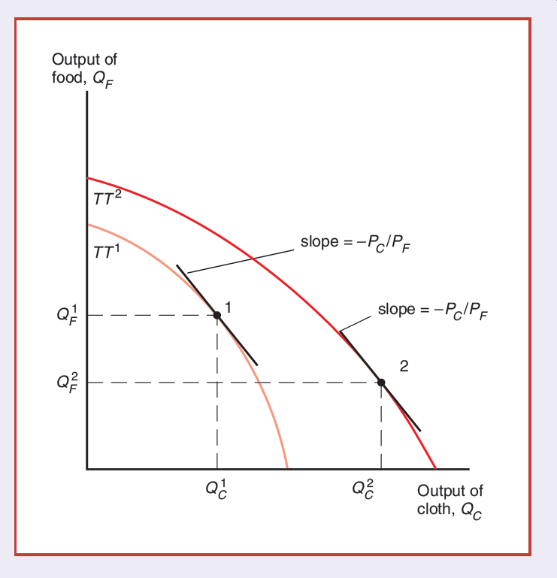
Resources and Production Possibilities
Resources and Production Possibilities
An increase in the supply of labor shifts the economy’s production possibility frontier outward from TT1 to TT2, but does so disproportionately in the direction of cloth production.
The result is that at an unchanged relative price of cloth (indicated by the slope -PC/PF), food production actually declines from QF1 to QF2.

Slide 27
A Model of a Two-Factor Economy
Factor Prices and Goods Prices
Stolper-Samuelson Theorem (effect):
If the relative price of a good increases, holding factor supplies constant, then the nominal and real return (in terms of both goods) to the factor used intensively in the production of that good increases, while the nominal and real return (in terms of both goods) to the other factor decreases.
The reverse is also true.

Slide 28
Effects of International Trade Between Two-Factor Economies
Trade and the Distribution of Income
Trade produces a convergence of relative prices.
Changes in relative prices have strong effects on the relative earnings of labor and land in both countries:
In Home, where the relative price of cloth rises:
Laborers are made better off and landowners are made worse off.
In Foreign, where the relative price of cloth falls, the opposite happens:
Laborers are made worse off and landowners are made better off.
Owners of a country’s abundant factors gain from trade, but owners of a country’s scarce factors lose.

Slide 29
Effects of International Trade Between Two-Factor Economies
Factor Price Equalization
In the absence of trade: labor would earn less in Home than in Foreign, and land would earn more.
Factor-Price Equalization Theorem:
International trade leads to complete equalization in the relative and absolute returns to homogeneous factors across countries.
It implies that international trade is a substitute for the international mobility of factors.

Slide 30
Empirical Evidence on the Heckscher-Ohlin Model
Testing the Heckscher-Ohlin Model
Tests on U.S. Data
Leontief paradox
Leontief found that U.S. exports were less capital-intensive than U.S. imports, even though the U.S. is the most capital-abundant country in the world.
Tests on Global Data
A study by Bowen, Leamer, and Sveikauskas tested the Heckscher-Ohlin model using data for a large number of countries.
This study confirms the Leontief paradox on a broader level.

Slide 31
Empirical Evidence on the Heckscher-Ohlin Model
Tests on North-South Trade
North-South trade in manufactures seems to fit the Heckscher-Ohlin theory much better than the overall pattern of international trade.
The Case of the Missing Trade
A study by Trefler in 1995 showed that technological differences across a sample of countries are very large.

Slide 32
Empirical Evidence on the Heckscher-Ohlin Model
Implications of the Tests
Empirical evidence on the Heckscher-Ohlin model has led to the following conclusions:
It has been less successful at explaining the actual pattern of international trade.
It has been useful as a way to analyze the effects of trade on income distribution.

Slide 33
Summary
The Heckscher-Ohlin model, in which two goods are produced using two factors of production, emphasizes the role of resources in trade.
A rise in the relative price of the labor-intensive good will shift the distribution of income in favor of labor:
The real wage of labor will rise in terms of both goods, while the real income of landowners will fall in terms of both goods.

Slide 34
Summary
For any given commodity prices, an increase in a factor of production increases the supply of the good that uses this factor intensively and reduces the supply of the other good.
The Heckscher-Ohlin theorem predicts the following pattern of trade:
A country will export that commodity which uses intensively its abundant factor and import that commodity which uses intensively its scarce factor.

Slide 35
Summary
The owners of a country’s abundant factors gain from trade, but the owners of scarce factors lose.
In reality, complete factor price equalization is not observed because of wide differences in resources, barriers to trade, and international differences in technology.
Empirical evidence is mixed on the Heckscher-Ohlin model.
Most researchers do not believe that differences in resources alone can explain the pattern of world trade or world factor prices.

